Slide 1
REVIEW PROJECT WORK-1
BE VII SEM

Slide 2
FOLIONEST
MOHAMMED ABDUL ADNAN(1604-20-737-043)
MOHD ABDUL MUQTADIR(1604-20-737-050)
MOHAMMED AZAM(1604-20-737-056)
UNDER THE GUIDANCE:DR. GOURI R. PATIL
DESIGNATION:ASSOCIATED PROFESSOR
MJCET

Slide 3
Introduction
FOLIONEST is a groundbreaking online platform designed to democratize
portfolio creation and foster meaningful connections between talented
individuals and companies. Users, spanning diverse fields from technology and
design to culinary arts and interior design, can effortlessly build and showcase
their portfolios within a user-friendly environment. Through personalized
templates and intuitive design tools, FOLIONEST transforms the portfolio
creation process into a seamless and engaging experience.
Tech enthusiasts can leverage FOLIONEST to craft portfolios that resonate with
industry standards, utilizing cutting-edge technologies such as React for the
frontend, Node.js for the backend, and MongoDB for secure data storage.
Simultaneously, professionals from various fields, including chefs, graphic
designers, artists, and interior designers, gain access to a dedicated portfolio
builder powered by advanced AI algorithms.
Built on a foundation of robust technologies, FOLIONEST ensures a secure and
dynamic user experience. What sets FOLIONEST apart is its inclusive approach.
The platform acts as a showcase of portfolio websites, bringing together a
diverse array of talent under one digital roof.
Companies, whether in the tech sector or other industries, can feature their own
portfolios, creating a hub for talent acquisition. With FOLIONEST, users can
seamlessly apply for opportunities posted by companies, bridging the gap
between skillful individuals and organizations seeking talent.

Slide 4
LITERATURE SURVEY
1. | Portfolio Building Platforms | Explore existing portfolio building platforms.Understand common features, user interfaces, and the targeted user base. | https://www.behance.net https://dribble.com https://carbonmade.com
2. | AI in Portfolio Building | Review literature on the integration of AI in portfolio creation.Explore research papers or articles on AI-driven content generation and recommendation systems.
3. | Social Networking Platforms | Analyze the strengths and weaknesses of social networking platforms like LinkedIn and Instagram.Understand the user engagement strategies employed by these platforms. | https://business.Instagram.com https://linkedin.com
4. | User Experience Design | Investigate principles of user experience (UX) design for portfolio and social networking websites.Explore how design choices impact user engagement and satisfaction. | https://www.uxdesigninstitute.com
5. | Community Building | Investigate strategies for building a vibrant online community.Explore how successful platforms foster user engagement and collaboration.

Slide 5
Disadvantages of existing system
Existing portfolio platforms often have complex interfaces, making it challenging for non-tech professionals to create and customize their portfolios effectively.
Some platforms cater predominantly to specific industries, leaving professionals from diverse fields with limited options for showcasing their skills.
Certain portfolio platforms may not prioritize visual appeal, resulting in portfolios that may not effectively capture the attention of potential collaborators or employers. While professional networks like LinkedIn exist, they may lack the dynamic and visually engaging aspects found in social platforms like Instagram, limiting the potential for meaningful connections.
Users may need to navigate between multiple platforms for portfolio creation, professional networking, and personal branding, resulting in a fragmented and less efficient user experience.

Slide 6
Problem statement
The project stems from a recognition of the existing challenges in current portfolio-building platforms, particularly for non-tech professionals. Many struggle with complex interfaces, lack of intuitive guidance, and limitations in representing diverse skills. The absence of dynamic networking features and concerns about security and privacy further compound these issues. FOLIONEST aims to bridge these gaps by providing a user-friendly, AI-powered platform that caters to professionals from various fields. The goal is to democratize portfolio creation, foster meaningful connections, and redefine how individuals showcase their talents in the digital professional landscape.

Slide 7
Proposed system
FOLIONEST operates as a user-centric, AI-powered platform that simplifies and enhances the portfolio-building experience. Users begin by logging in to a visually appealing interface that combines the best aspects of Instagram and LinkedIn. The intuitive drag-and-drop interface allows effortless portfolio creation, with AI stepping in to provide personalized content suggestions, ensuring each user's uniqueness shines through.The platform's inclusive design accommodates professionals from various fields, offering industry-specific templates and tools for both tech and non-tech backgrounds.FOLIONEST's innovative approach transforms portfolio building into a creative and collaborative journey. From personalized content suggestions to dynamic networking, the platform redefines how professionals showcase their talents, fostering a supportive community and bridging the gaps left by traditional portfolio builders.

Slide 8
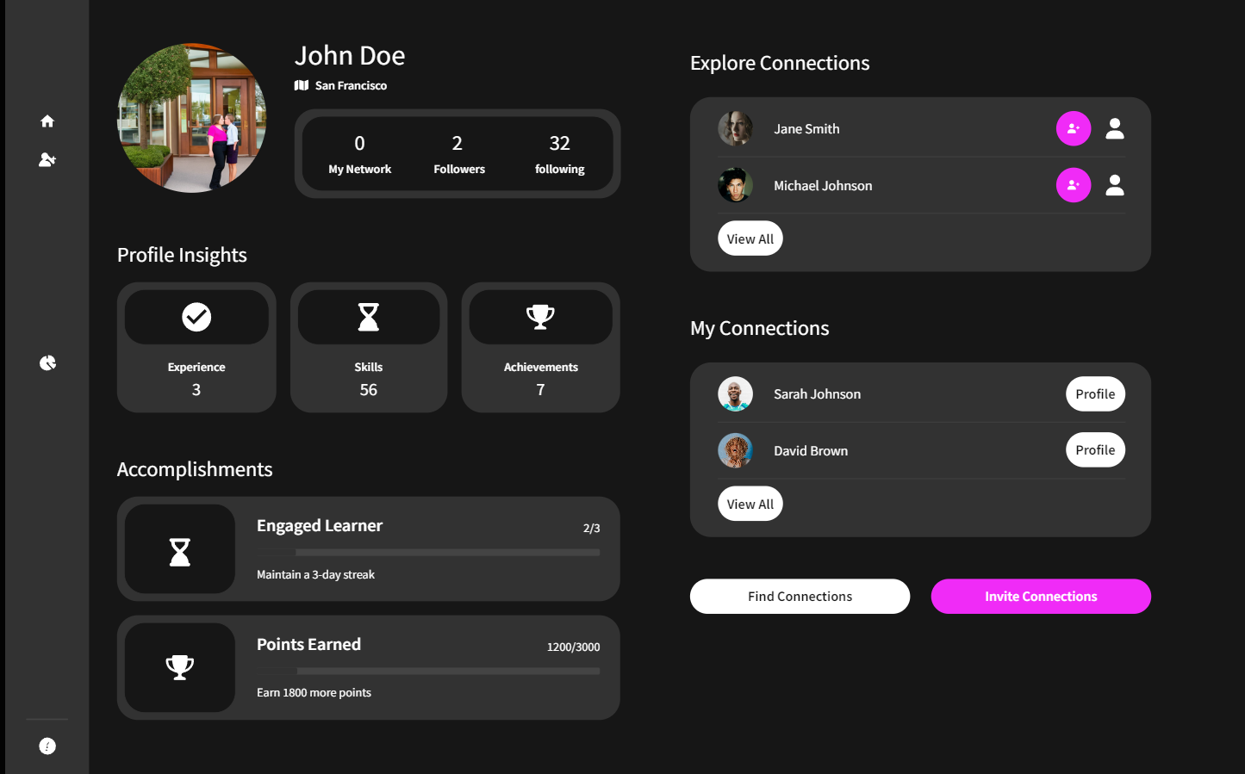
PROTOTYPE IMAGES

Slide 9
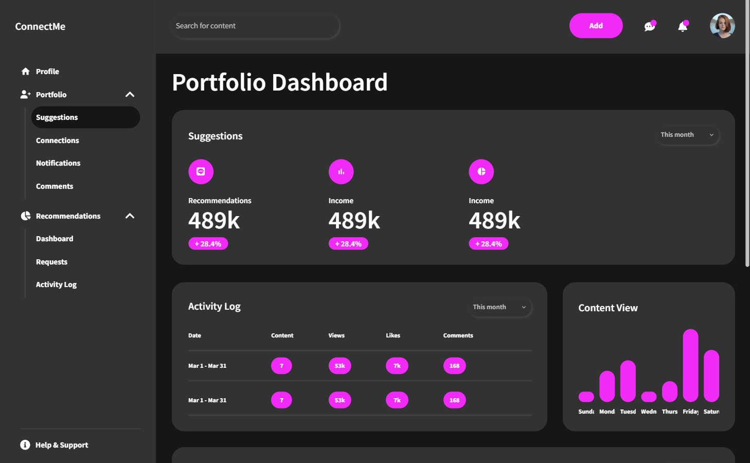

Slide 10
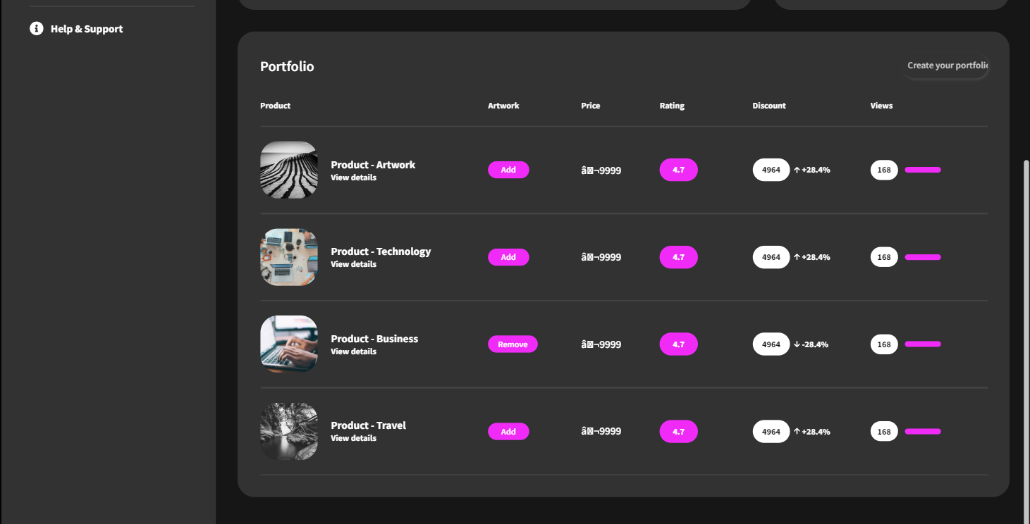

Slide 11
TIMELINE
Week:1-3
Week:3-9
Week:9-16
Week:16-17
Week:17-19
Week:19-30
Week:30-32
Week:32
Problem Definition
& Abstract
Literature Survey
System Analysis
REVIEW-I
System Design
Implementation
Testing & Documentation
REVIEW-II

Slide 12
REFRENCES
https://www.behance.net
https://dribble.com
https://carbonmade.com
https://business.Instagram.com
https://linkedin.com
https://www.uxdesigninstitute.com

Slide 13
THANK YOU

